Slide 1
Machine Learning II
” You can’t process me with a normal brain.”
— Charlie Sheen
Lecture 2
Neural Networks basic

Slide 2
What is Neural Network

Slide 3
What is Neural Network?
Price of the house
Size of the house
Price of the house
f(x)
neuron
Activation function
f(x) can be SVM, linear regression, decision tree, ….
Size of the house

Slide 4
What is Neural Network?
What if more parameters are involved in price of the house?
Size
Family size
No. of bedrooms
Walkability
Price
Address
School quality
Wealth
Output Layer
Input Layer
Hidden Layer
Deep learning by Andrew NG

Slide 5

Properties of Neural Networks
High level abstraction of neural input-output transformation
Inputs → weighted sum of inputs → nonlinear function → output
Often used where data or functions are uncertain
Goal is to learn from a set of training data
And to generalize from learned instances to new unseen data
Key attributes
Parallel computation
Distributed representation and storage of data
Learning (networks adapt themselves to solve a problem)
Fault tolerance (insensitive to component failures)

Slide 6
Topologies of Neural Networks
completely connected
feedforward
(directed, a-cyclic)
recurrent
(feedback connections)

Slide 7
Some Networks Types
Feedforward versus recurrent networks
Feedforward: No loops, input → hidden layers → output
Recurrent: Use feedback (positive or negative)
Continuous versus spiking
SNNs operate using spikes, which are discrete events that take place at points in time, rather than continuous values
SNNs incorporate the concept of time into their operating model. The idea is that neurons in the SNN do not fire at each propagation cycle
Supervised versus unsupervised learning
Supervised networks use a “teacher”
The desired output for each input is provided by user
Unsupervised networks find hidden statistical patterns in input data
Clustering, principal component analysis

Slide 8
Critical Decisions
Construction of a neural network involves several critical decisions:
Number of hidden layers
Number of nodes in each hidden layer
Choice of activation function
Number of iterations of backpropagation applied
Number of input attributes

Slide 9
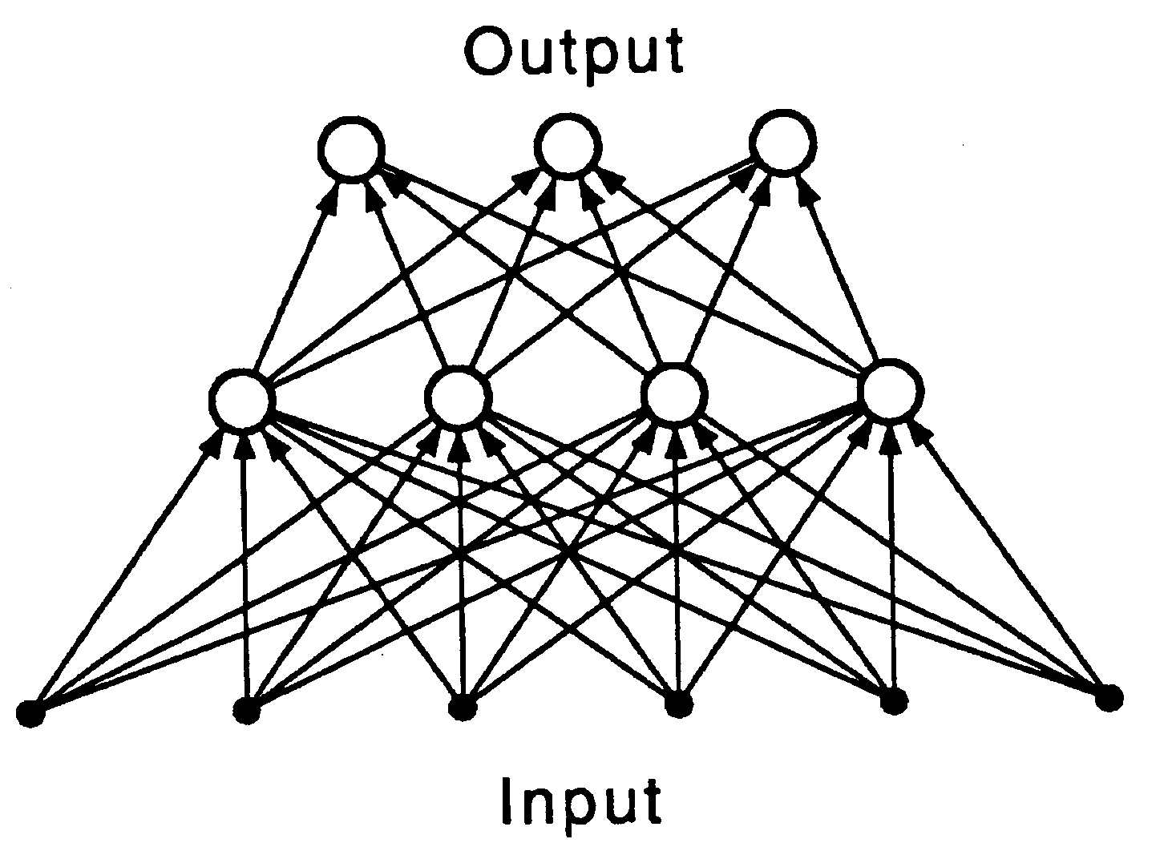
Learning networks
We want networks that configure themselves
Learn from the input data or from training examples
Generalize from learned data
Can this network configure itself to solve a problem?
How do we train it?

Slide 10
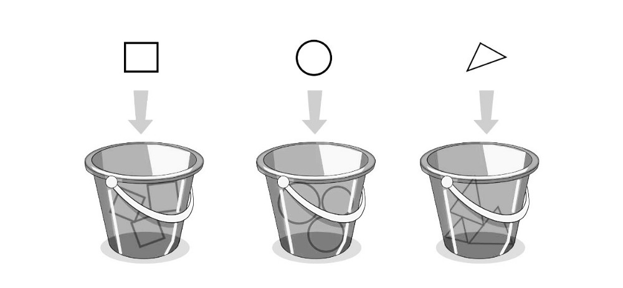
Classification
As for this pattern of connections, the main distinction we can make is between:
Feed-forward networks, where the data flow from input to output units is strictly feed-forward. The data processing can extend over multiple layers of units, but no feedback connections or connections between units of the same layer are present.

Slide 11
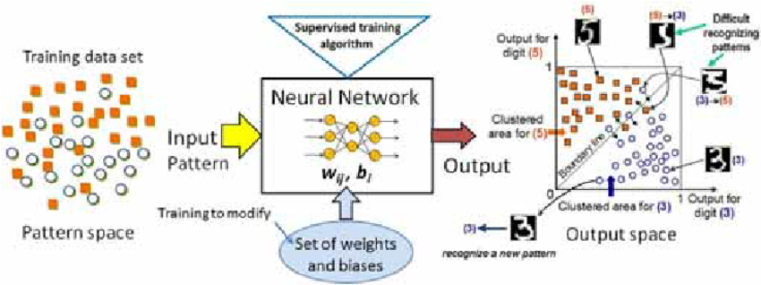
Clustering

Slide 12
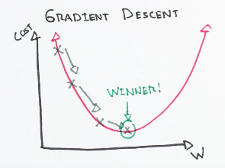
Optimization and Gradient-descent

Slide 13
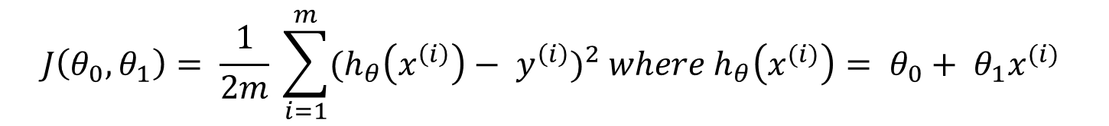


The Cost Function
$${hypothesis: h}_{θ}\left(x\right)= θ_{0}+ θ_{1}x$$
$$J\left(θ_{0}, θ_{1}\right)= \frac{1}{2m} \sum_{i=1}^{m}{{(h_{θ}\left(x^{\left(i\right)}\right)− y^{\left(i\right)})}^{2} where h_{θ}\left(x^{(i)}\right)= θ_{0}+ θ_{1}x^{(i)} }$$
minimize $J(θ_{0}, θ_{1})$

Slide 14
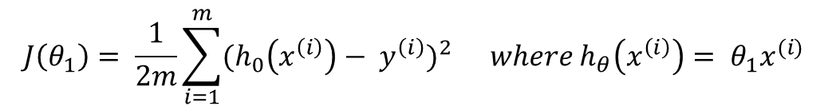

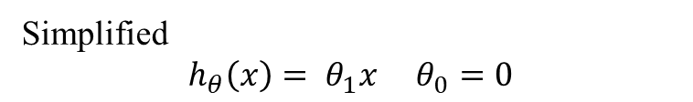




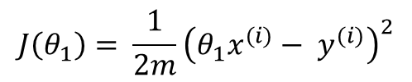
Simplified Problem $θ_{0}=0$
$${hypothesis: h}_{θ}\left(x\right)= θ_{0}+ θ_{1}x$$
$$θ^{T}X$$
$${parameters: θ}_{0}, θ_{1}$$
$$Cost fn: J\left(θ_{0}, θ_{1}\right)= \frac{1}{2m} \sum_{i=1}^{m}{{(h_{θ}\left(x^{\left(i\right)}\right)− y^{\left(i\right)})}^{2} where h_{θ}\left(x^{(i)}\right)= θ_{0}+ θ_{1}x^{(i)} }$$
$$Goal: \begin{matrix}minimize \\ θ_{0}, θ_{1}\end{matrix} J(θ_{0}, θ_{1})$$
Simplified
$$h_{θ}\left(x\right)= θ_{1}x θ_{0}=0$$
$$J\left(θ_{1}\right)= \frac{1}{2m}\sum_{i=1}^{m}{{(h_{0}\left(x^{\left(i\right)}\right)− y^{\left(i\right)})}^{2}} where h_{θ}\left(x^{\left(i\right)}\right)= θ_{1}x^{(i)}$$
$$J\left(θ_{1}\right)= \frac{1}{2m}{\left(θ_{1}x^{(i)}− y^{(i)}\right)}^{2}$$

Slide 15


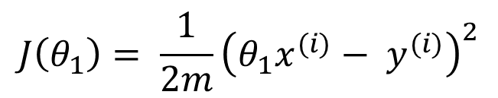



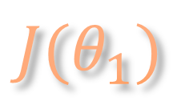


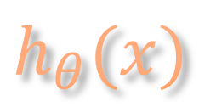




$$h_{θ}(x)$$
$$J(θ_{1})$$
(for fixed $θ_{1}$ this is a function of x)
(function of the parameter $θ_{1}$)
$$J(θ_{1})$$
$$h_{θ}(x)$$
$$θ_{1}=1$$
$$J\left(−.5\right)≈3.46$$
$$J\left(.5\right)≈0.58$$
$$J\left(1\right)=0$$
$$1$$
$$θ_{1}$$
$$J\left(θ_{1}\right)= \frac{1}{2m}{\left(θ_{1}x^{(i)}− y^{(i)}\right)}^{2}$$
$$h_{θ}\left(x\right)= θ_{1}x θ_{0}=0$$
Prof. Andrew Ng,
Stanford University, Machine Learning

Slide 16
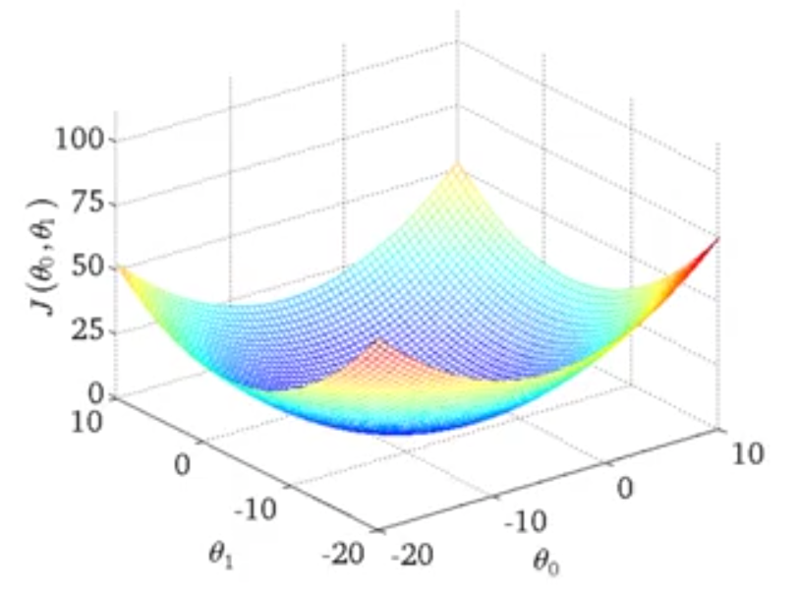

Surface Plot of Cost Function
$$θ_{0}≠0$$
Prof. Andrew Ng,
Stanford University , Machine Learning

Slide 17
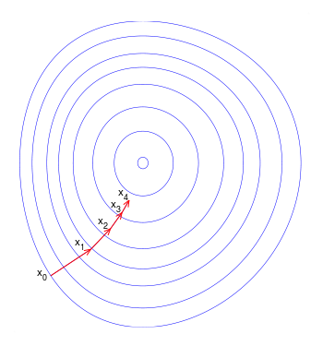
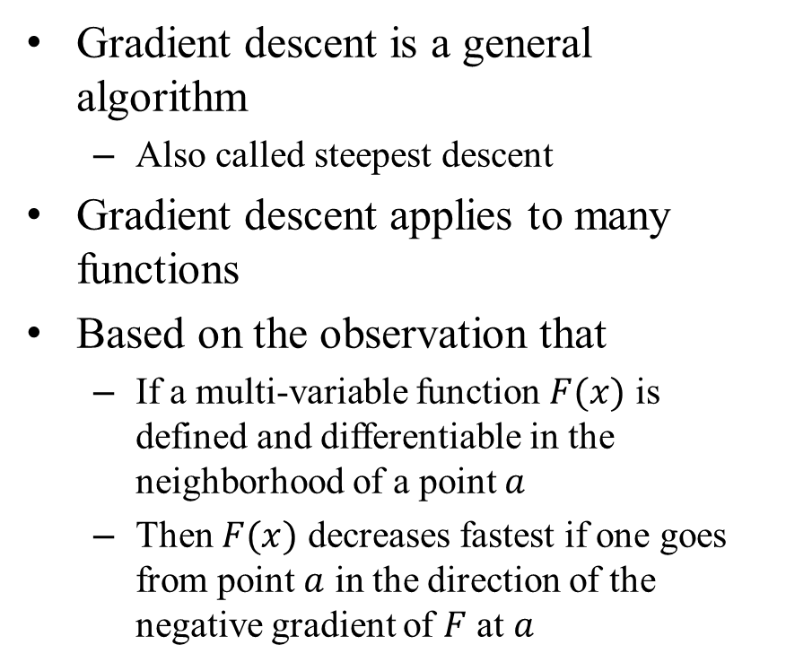
Foundation for Gradient Descent
Gradient descent is a general algorithm
Also called steepest descent
Gradient descent applies to many functions
Based on the observation that
If a multi-variable function $F(x)$ is defined and differentiable in the neighborhood of a point $a$
Then $F(x)$ decreases fastest if one goes from point $a$ in the direction of the negative gradient of $F$ at $a$
From Wikipedia at: https://en.wikipedia.org/wiki/Gradient_descent

Slide 18

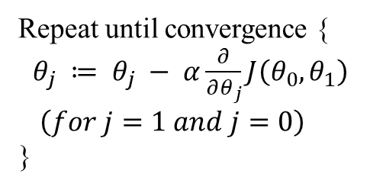
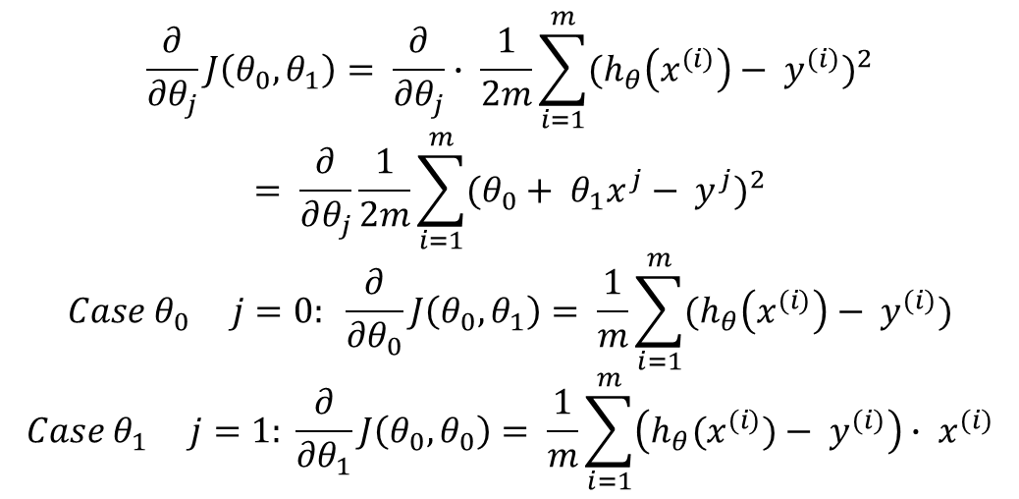

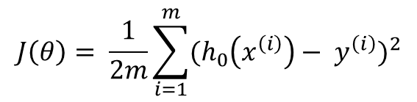
A Worked Example
Gradient Descent Algorithm
Regression Model
Repeat until convergence {
$θ_{j} ≔ θ_{j} − α\frac{∂}{∂θ_{j}}J\left(θ_{0}, θ_{1}\right)$
$\left(for j=1 and j=0\right)$
}
$$h_{θ}\left(x\right)= θ_{0}+ θ_{1}x$$
$$J\left(θ\right)= \frac{1}{2m}\sum_{i=1}^{m}{{(h_{0}\left(x^{\left(i\right)}\right)− y^{\left(i\right)})}^{2}}$$
$$\begin{matrix}minimize \\ θ_{0}, θ_{1}\end{matrix} J(θ_{0}, θ_{1})$$
$$\frac{∂}{∂θ_{j}}J\left(θ_{0}, θ_{1}\right)= \frac{∂}{∂θ_{j}}∙ \frac{1}{2m}\sum_{i=1}^{m}{{(h_{θ}\left(x^{(i)}\right)− y^{(i)})}^{2}}$$
$$= \frac{∂}{∂θ_{j}}\frac{1}{2m}\sum_{i=1}^{m}{{(θ_{0}+ θ_{1}x^{j}− y^{j})}^{2}}$$
$$Case θ_{0} j=0: \frac{∂}{∂θ_{0}}J\left(θ_{0}, θ_{1}\right)= \frac{1}{m}\sum_{i=1}^{m}{(h_{θ}\left(x^{(i)}\right)− y^{(i)})}$$
$$Case θ_{1} j=1: \frac{∂}{∂θ_{1}}J\left(θ_{0}, θ_{0}\right)= \frac{1}{m}\sum_{i=1}^{m}{\left(h_{θ}{(x}^{(i)})− y^{(i)}\right)}∙ x^{(i)}$$

Slide 19
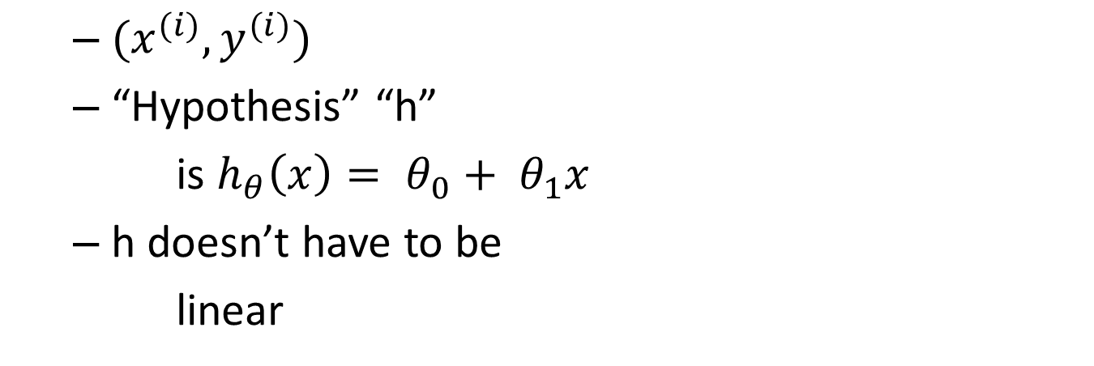


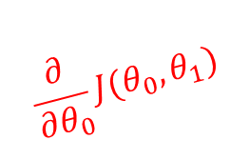
Gradient Descent Algorithm
$$\frac{∂}{∂θ_{0}}J(θ_{0}, θ_{1})$$
Repeat until convergence {
$θ_{0} := θ_{0}− α\frac{1}{m}\sum_{i=1}^{m}{(h_{θ}\left(x^{(i)}\right)− y^{(i)})}$
$θ_{1} := θ_{1}− α\frac{1}{m}\sum_{i=1}^{m}{\left(h_{θ}\left(x^{\left(i\right)}\right)− y^{\left(i\right)}\right)} ∙ x^{(i)}$
}
Update
$$θ_{0} and θ_{1}$$
Simultaneously!
$$\frac{∂}{∂θ_{1}}J(θ_{0}, θ_{1})$$

Slide 20




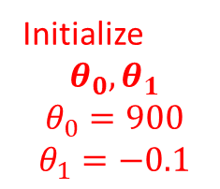

Gradient Descent Pictorially
$$h\left(x^{1}\right)=900 −0.1x$$
500
Initialize
$$θ_{0}, θ_{1}$$
$$θ_{0}=900$$
$$θ_{1}=−0.1$$
x
400
x
x
x
x
x
x
x
Price
($ in 1,000’s)
x
x
x
$$θ_{1}$$
300
x
x
x
x
x
x
x
x
200
x
x
x
x
x
100
1000
2000
3000
$$θ_{0}$$
Size (ft²)
$$h_{θ}(x)$$
$$J(θ_{0}, θ_{1})$$

Slide 21
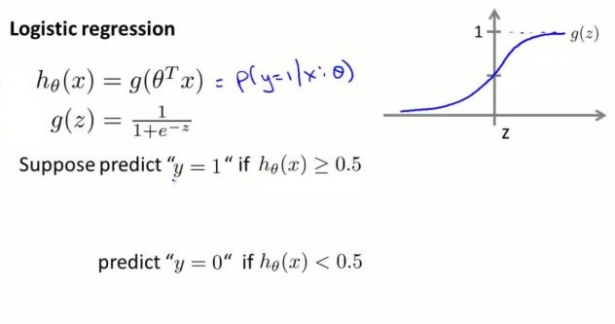
Logistic Regression
Prof. Andrew Ng,
Stanford University , Machine Learning

Slide 22
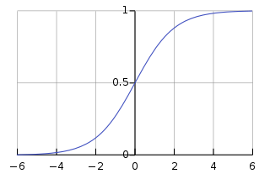
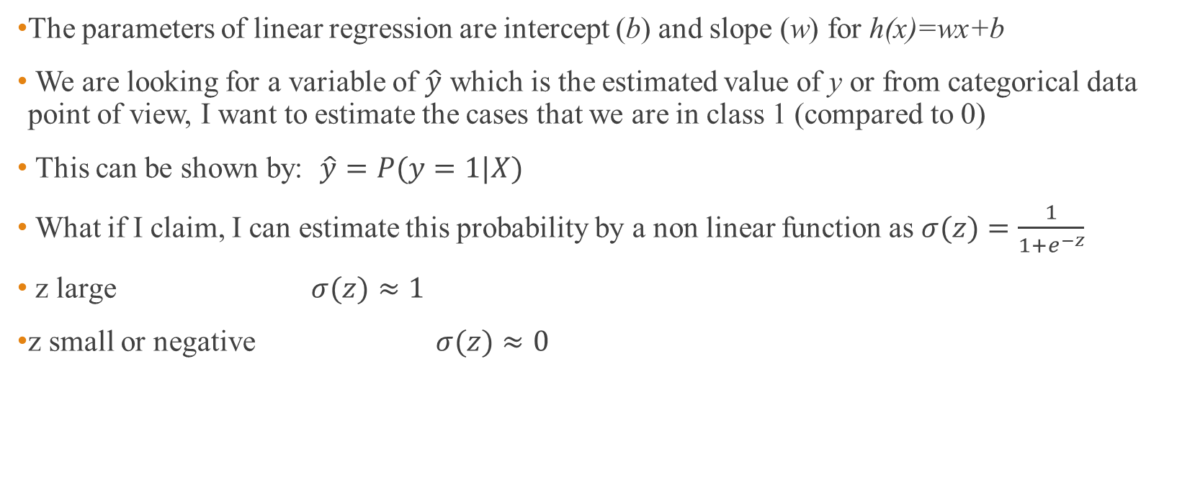



Logistic Regression
bias
weight
The parameters of linear regression are intercept (b) and slope (w) for h(x)=wx+b
We are looking for a variable of $\hat{y}$ which is the estimated value of y or from categorical data point of view, I want to estimate the cases that we are in class 1 (compared to 0)
This can be shown by: $\hat{y}=P(y=1|X)$
What if I claim, I can estimate this probability by a non linear function as $σ(z)=\frac{1}{1+e^{−z}}$
z large $σ(z)≈1$
z small or negative $σ(z)≈0$
Sigmoid function
$$σ(z)$$
$$\hat{y}=σ(wx+b)$$
$$z$$
Prof. Andrew Ng,
Stanford University , Machine Learning

Slide 23
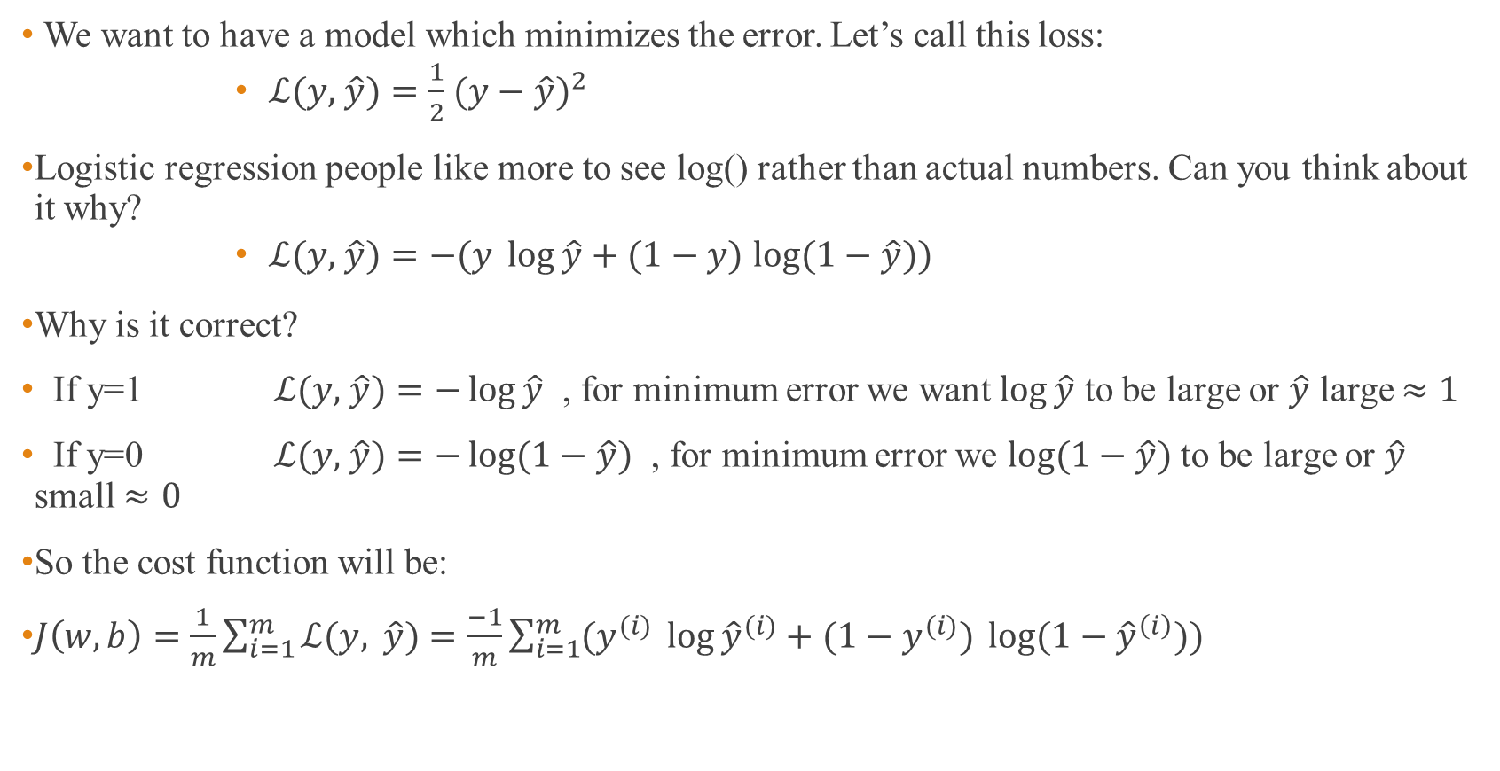
Logistic Regression
We want to have a model which minimizes the error. Let’s call this loss:
$ℒ(y,$ $\hat{y})=\frac{1}{2}$ $(y−$ $\hat{y})^{2}$
Logistic regression people like more to see log() rather than actual numbers. Can you think about it why?
$ℒ(y,$ $\hat{y})=−(y \log{\hat{y}}+(1−y)$ $\log{(1−\hat{y})})$
Why is it correct?
If y=1 $ℒ(y,$ $\hat{y})=−\log{\hat{y}}$ , for minimum error we want $\log{\hat{y}}$ to be large or $\hat{y}$ large $≈1$
If y=0 $ℒ(y,$ $\hat{y})=−\log{(1−\hat{y})}$ , for minimum error we $\log{(1−\hat{y})}$ to be large or $\hat{y}$ small $≈0$
So the cost function will be:
$J\left(w,b\right)=\frac{1}{m}\sum_{i=1}^{m}{ℒ(y, \hat{y})}=\frac{−1}{m}\sum_{i=1}^{m}{(y^{(i)} \log{{\hat{y}}^{(i)}}+(1−y^{(i)}) \log{(1−{\hat{y}}^{\left(i\right)})}) }$
Prof. Andrew Ng,
Stanford University , Machine Learning

Slide 24
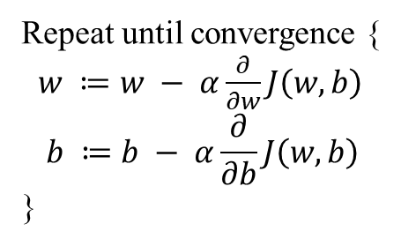
Gradient descent
Gradient Descent Algorithm
Repeat until convergence {
$w ≔w − α\frac{∂}{∂w}J\left(w, b\right)$
$$b ≔b − α\frac{∂}{∂b}J\left(w, b\right)$$
}

Slide 25

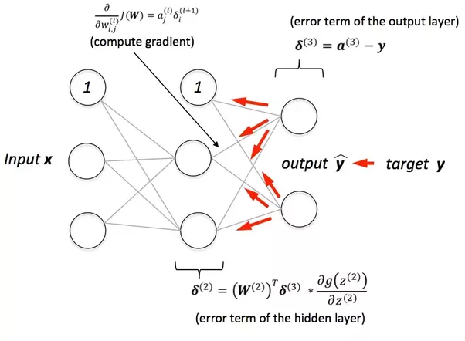
Backpropagation

Slide 26
Summary: Biology and Neural Networks
So many similarities
Information is contained in synaptic connections
Network learns to perform specific functions
Network generalizes to new inputs
But NNs are woefully inadequate compared with biology
Simplistic model of neuron and synapse, implausible learning rules
Hard to train large networks
Network construction (structure, learning rate etc.) is a heuristic art
One obvious difference: Spike representation
Recent models explore spikes and spike-timing dependent plasticity
Other Recent Trends: Probabilistic approach
NNs as Bayesian networks (allows principled derivation of dynamics, learning rules, and even structure of network)
Not clear how neurons encode probabilities in spikes

